Slide 1

Wine Quality Prediction
SEIS 763: Machine Learning
Presenter: Garth Mortensen

Slide 2
Purpose
Given various attributes such as acidity, chlorides, pH and alcohol, identify which category (Good/Bad) a new wine bottle belongs to, using classification.
Find the best model, then optimize it.
Notes:
1 minute

Slide 3
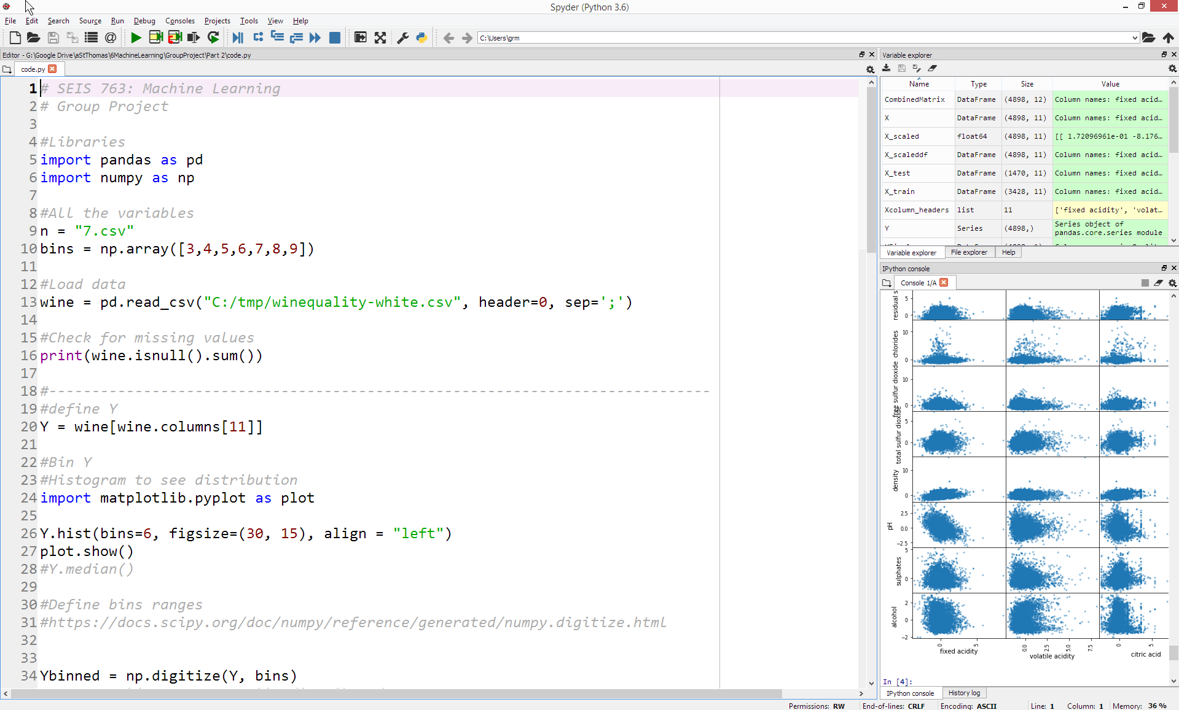
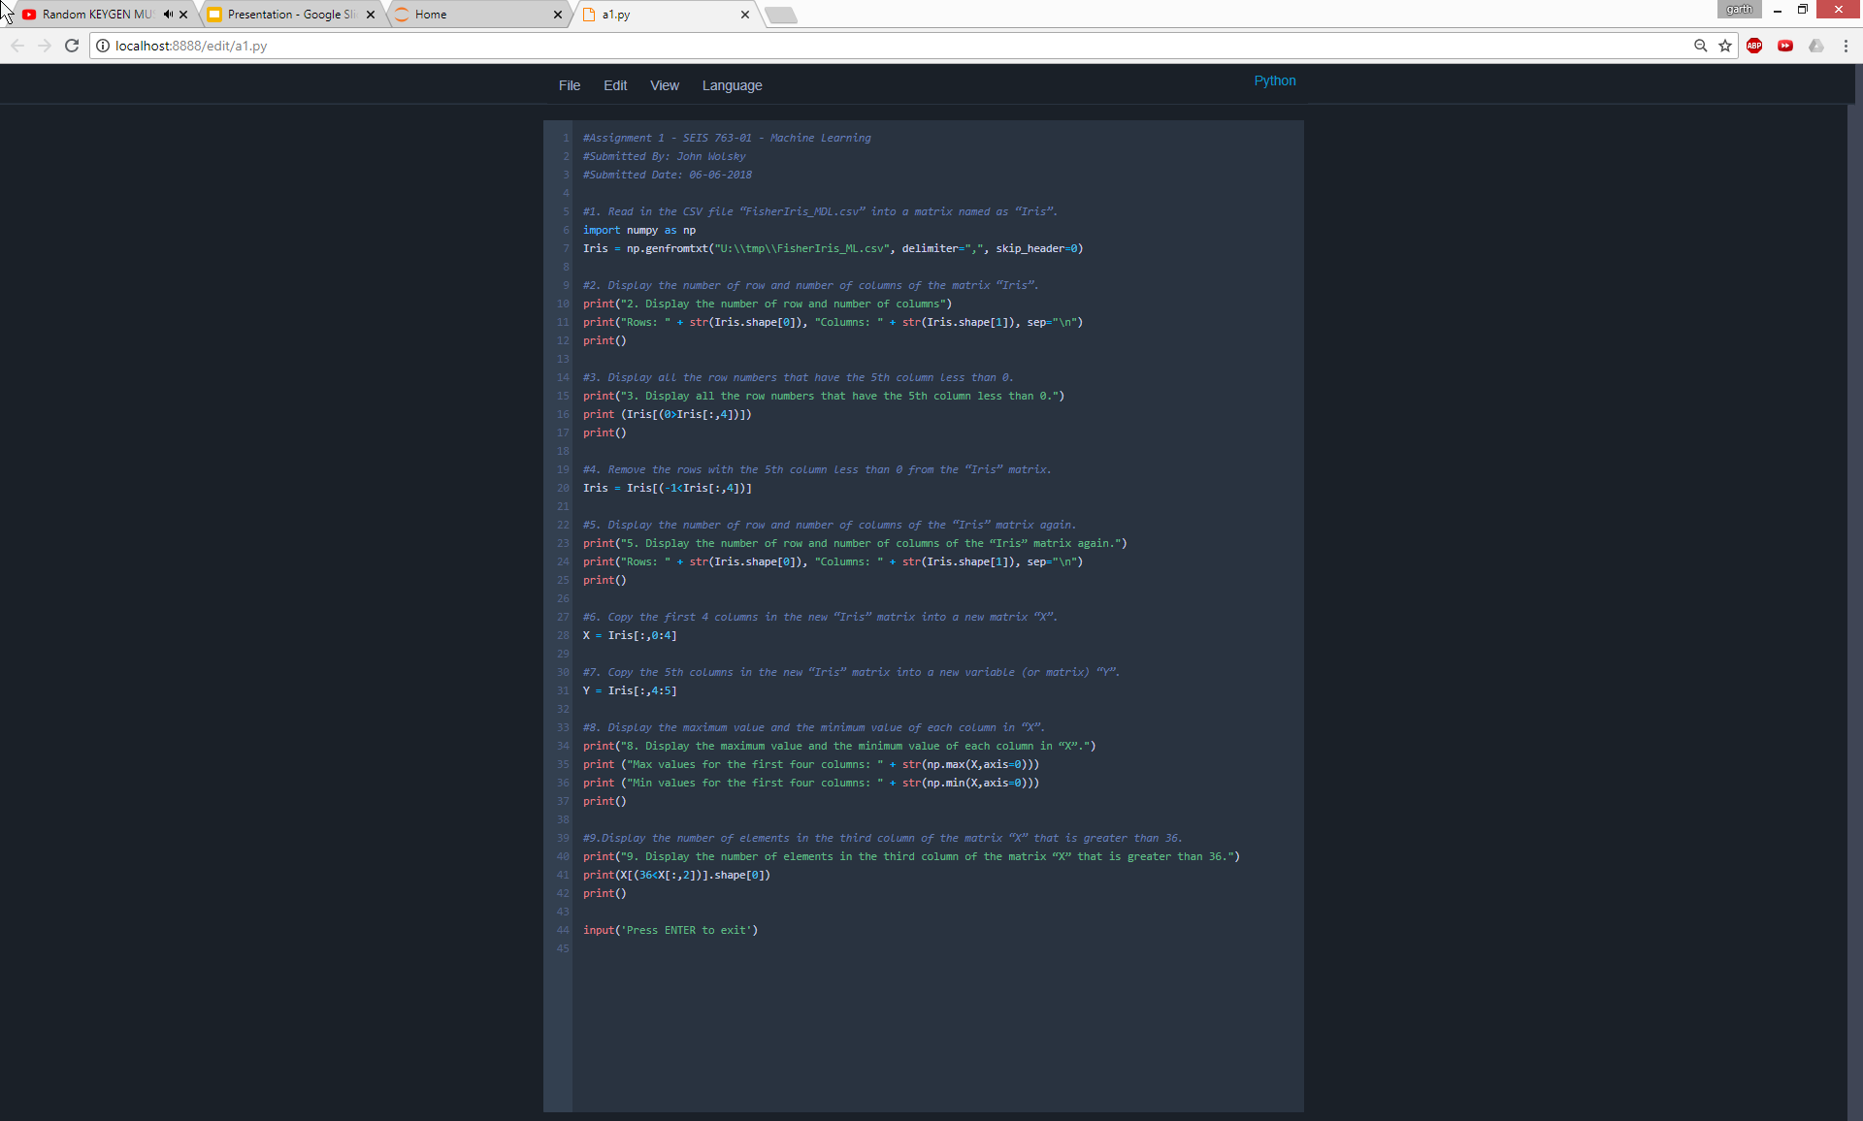
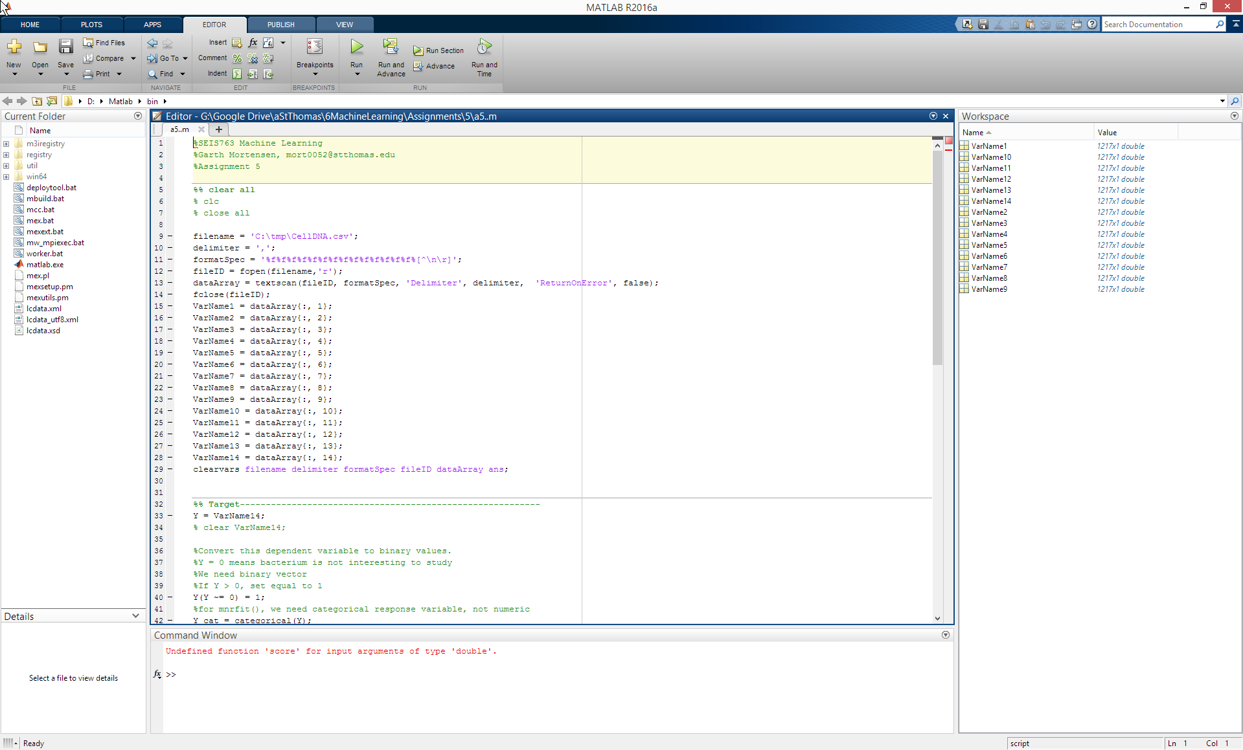
Software/Tools Used
Python (data loading, prep, splitting)
Spyder
Jupyter
MatLab (modeling, scoring, optimizing)
ΣLOC = 900+

Slide 4
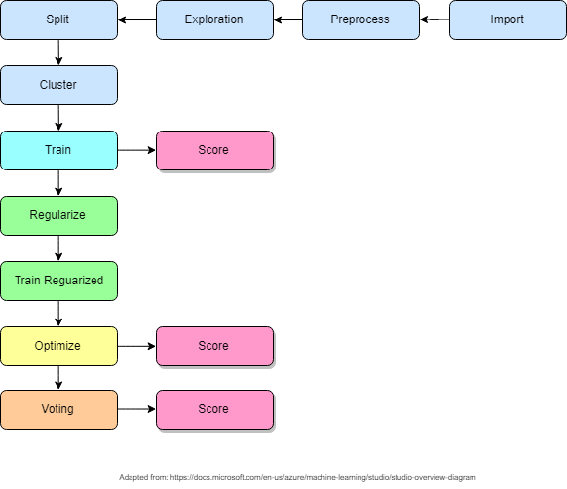

Slide 5
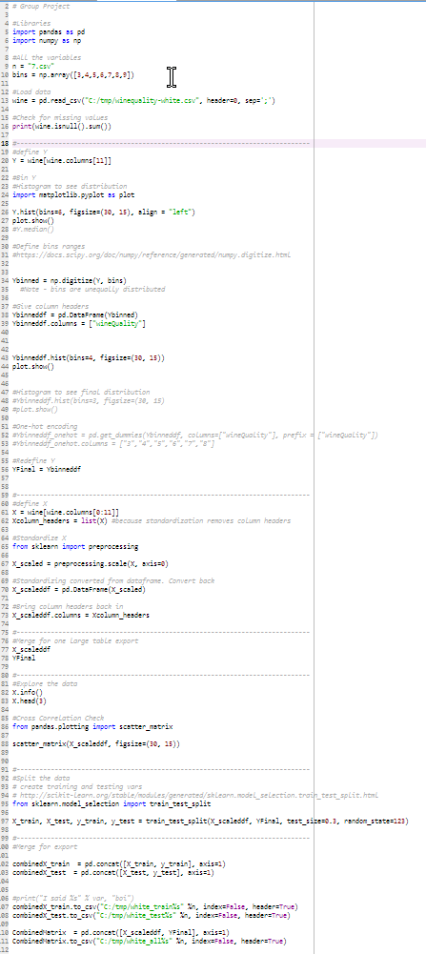
Data Set & Cleaning
X
Data skewed between Red and White wine
Red = 1,599 x 12
White = 4,898 x 12
No NULL entries
Predictors
All are numerical
All have been standardized
Target
Categorical (3, 9)
Notes:
3 minutes

Slide 6
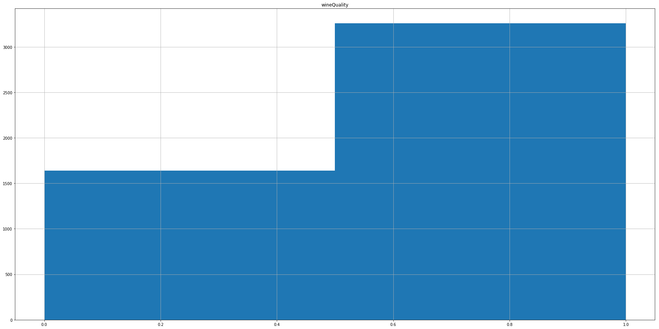
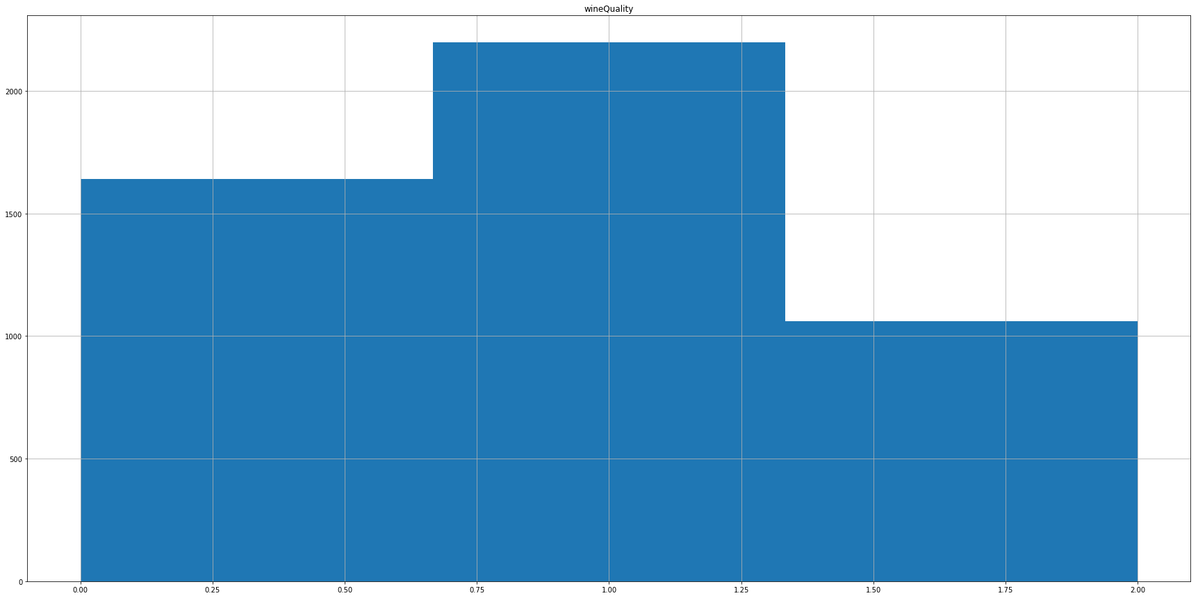
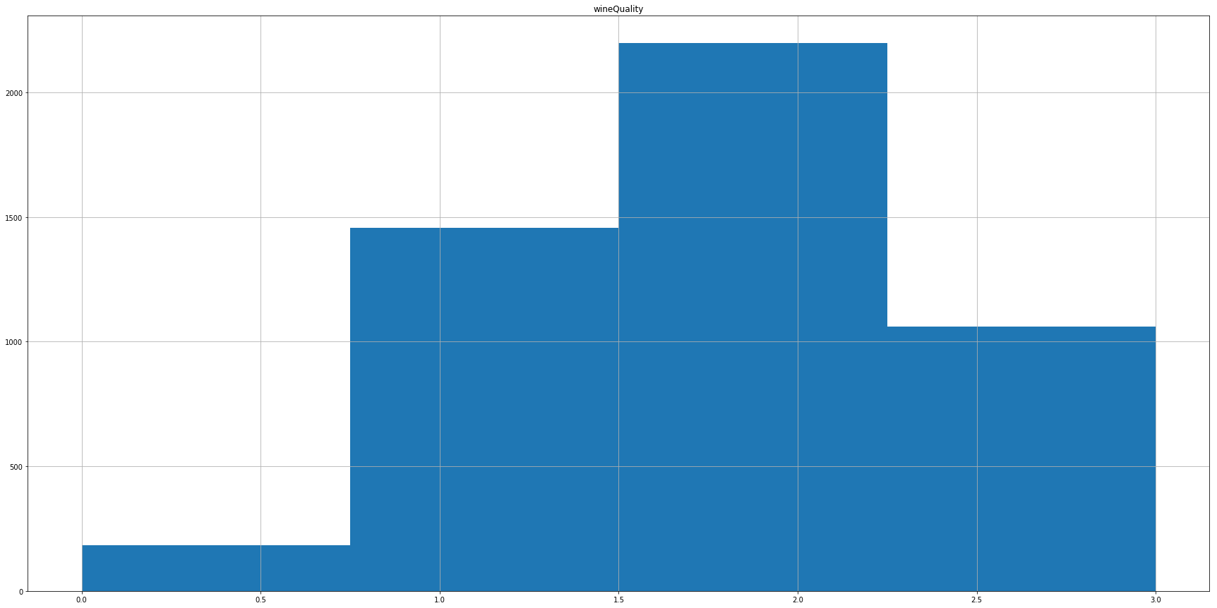
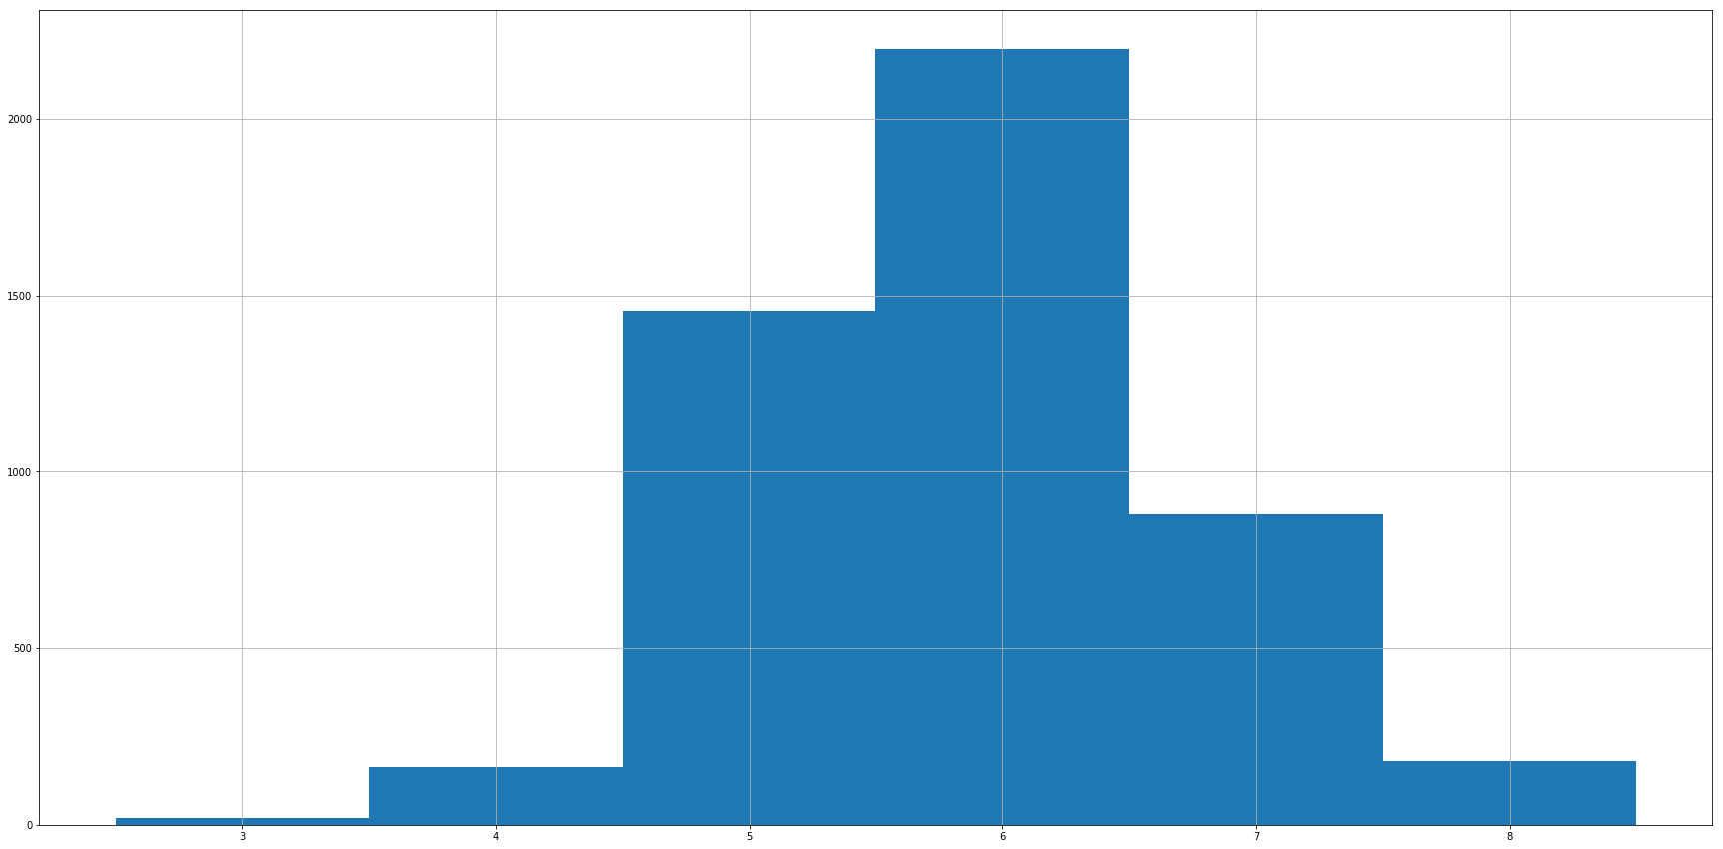
Y bins = 2 (6, 10)
Y bins = 3 (6, 7, 10)
Y bins = 4 (5, 6, 7, 10)
Y bins = 7 (default)

Slide 7
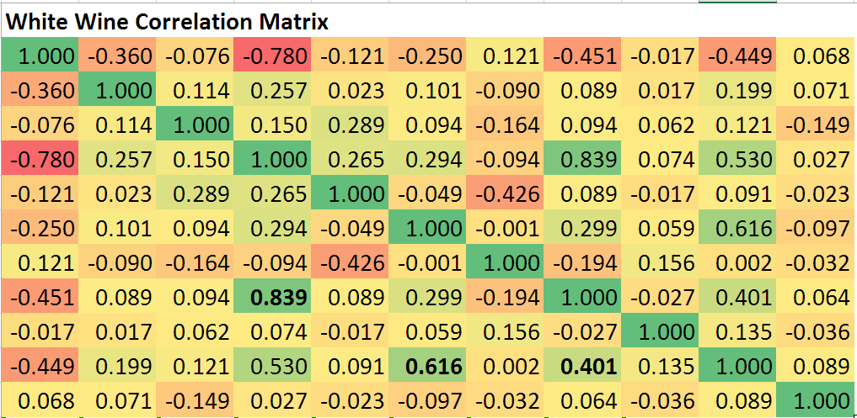
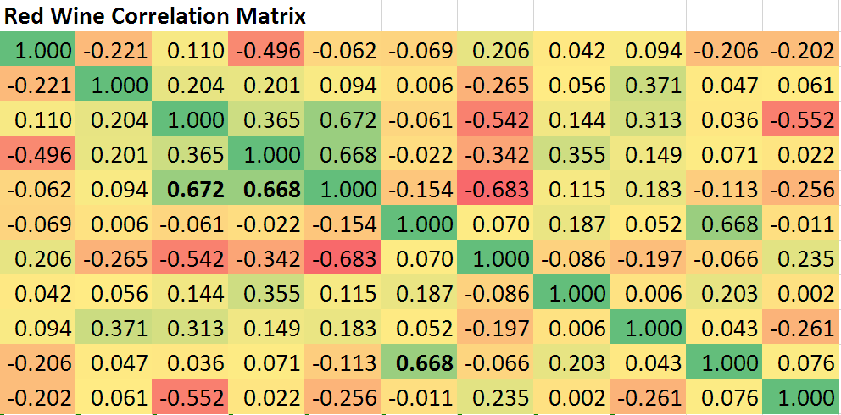
Correlation check
%numeric correlation [correlation, pval] = corr([alcohol, chlorides, citricacid, density, fixedacidity, freesulfurdioxide, pH, residualsugar, sulphates, totalsulfurdioxide, volatileacidity]);
Max(abs(corr))
Notes:
Correlation is covariance, after normalizing. Therefore, it is less susceptible to $ vs age

Slide 8
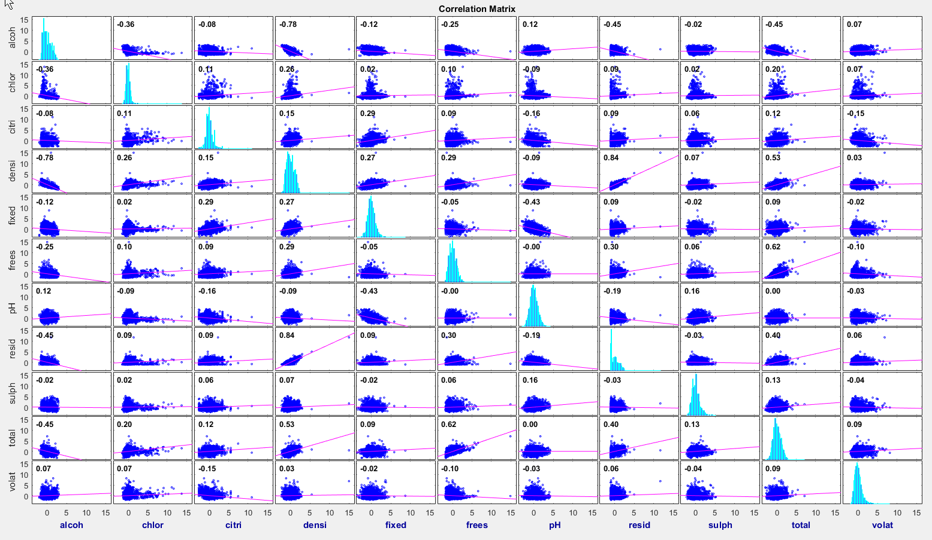
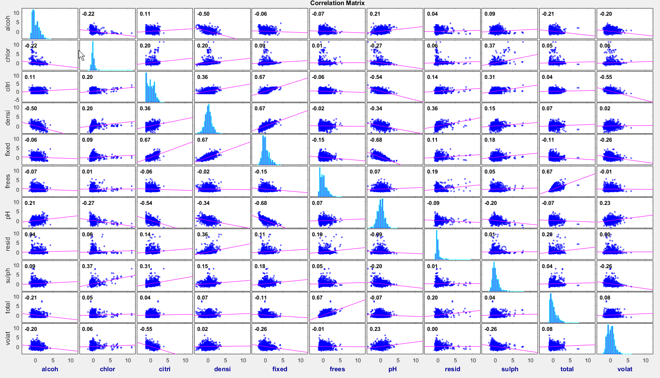
WHITE
RED
Notes:
Huimin

Slide 9
Randomized 70-30 Split
X
X_train, X_test, y_train, y_test = train_test_split(X_scaleddf, YFinal, test_size=0.3, random_state=123)
Data split 70-30 between training and testing
Random seed = 123
Notes:
Huimin

Slide 10
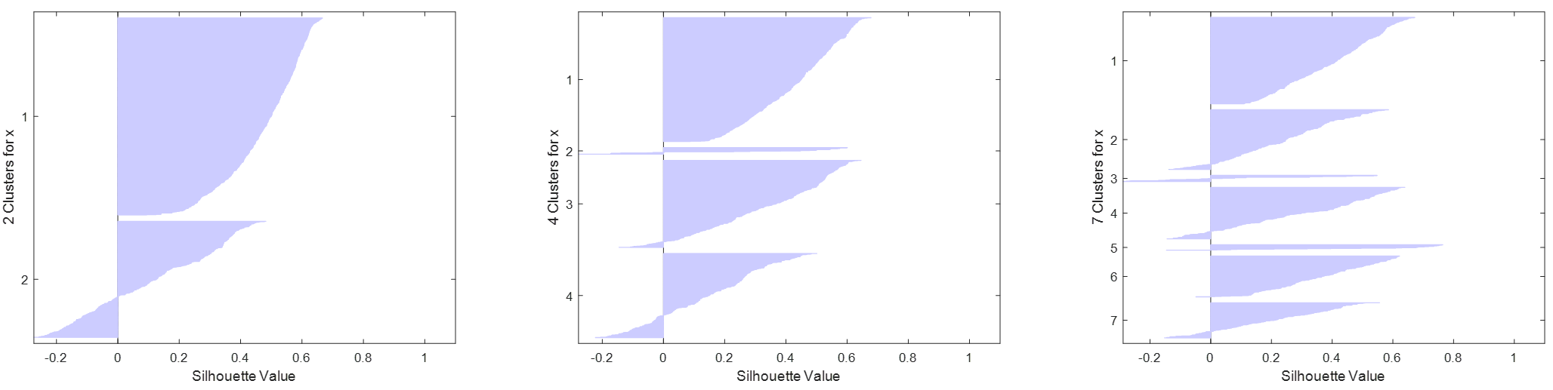
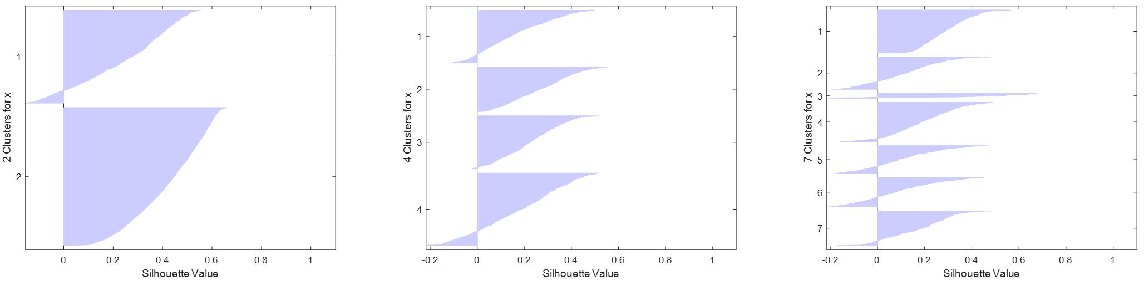
Any Natural Cluster? K-Means
Coherence (Internal)
Red
Could remove boundary points for better separation
Seperation
(External)
White
Notes:
Huimin:white:clusterx2 = 0.3533 clusterx4 = 0.2012 clusterx7 = 0.1741 Red: clusterx2 =0.3430 clusterx4 = 0.3189 clusterx7 =0.3126
Silhouette plot shows how well-separated the resulting clusters are. It displays a measure of how close each point in one cluster is to points in the neighboring clusters. This measure ranges from >=1, indicating points that are very distant from neighboring clusters, through 0, indicating points that are not distinctly in one cluster or another, to -1, indicating points that are probably assigned to the wrong cluster.

Slide 12
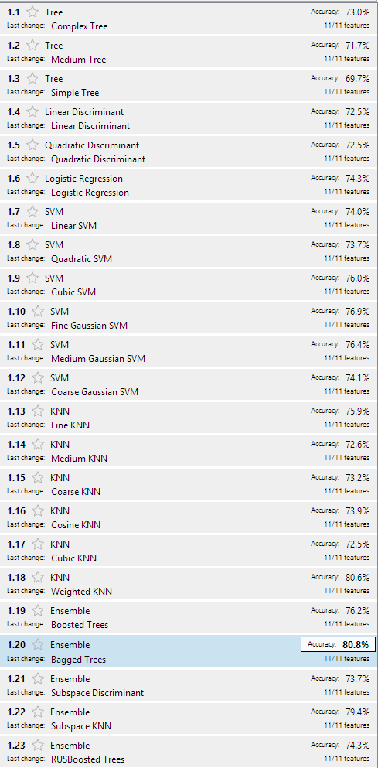
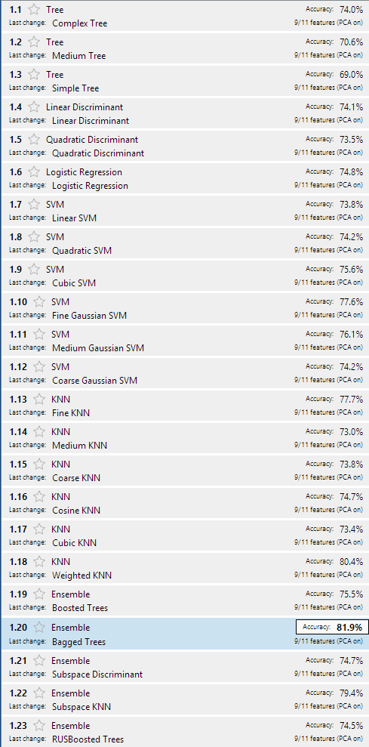
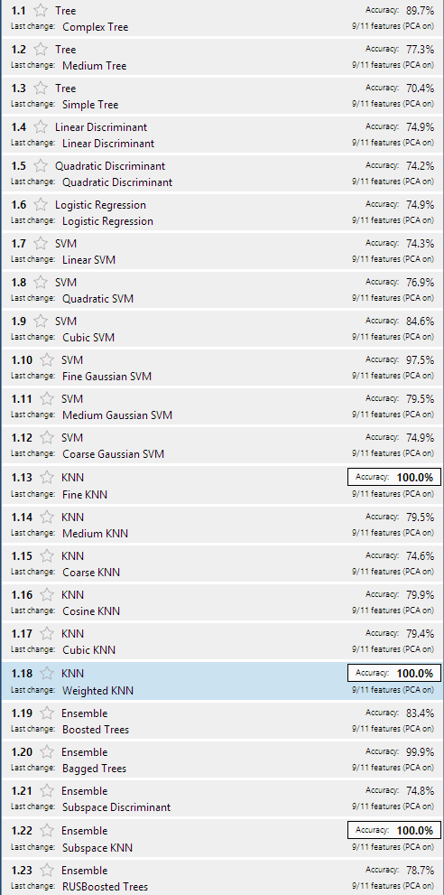
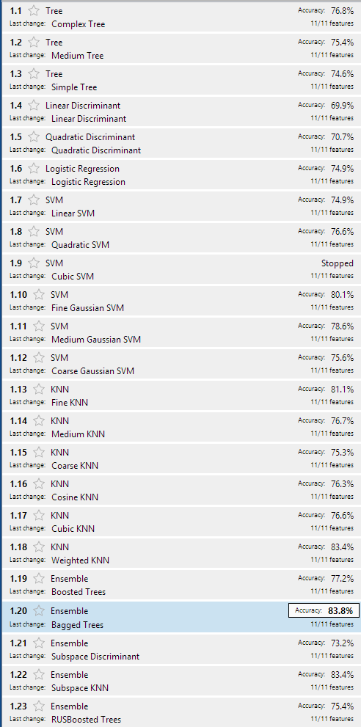
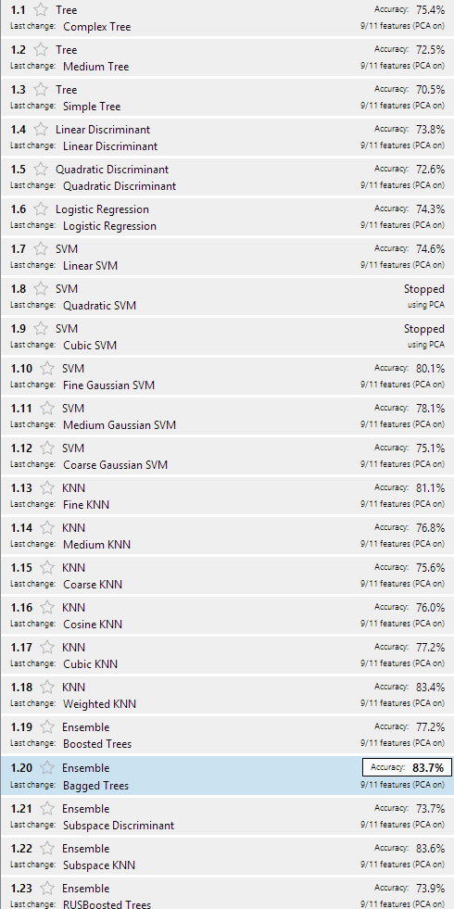
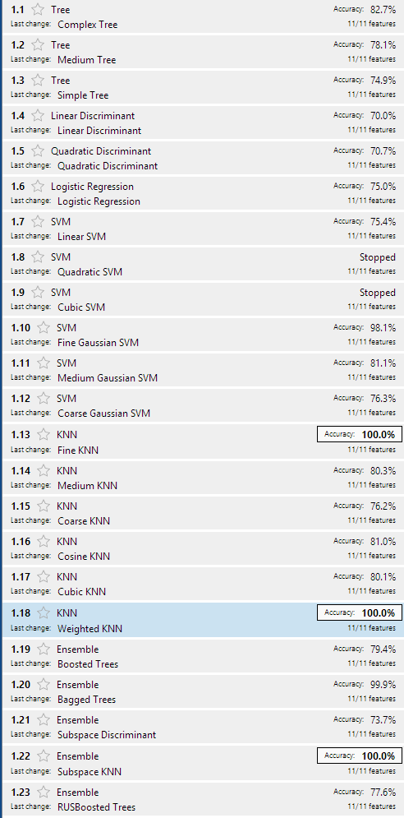
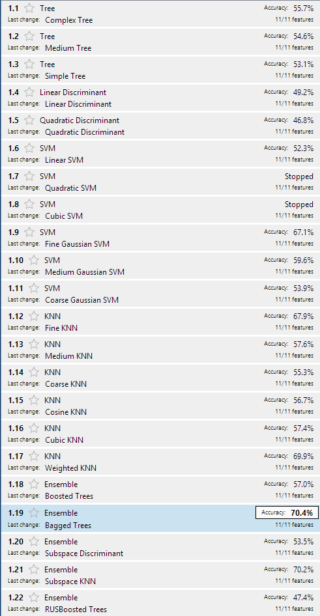
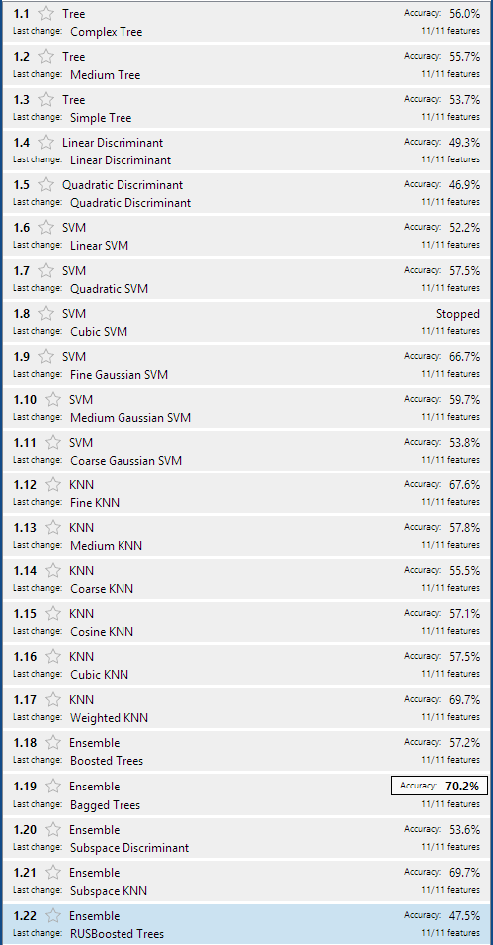
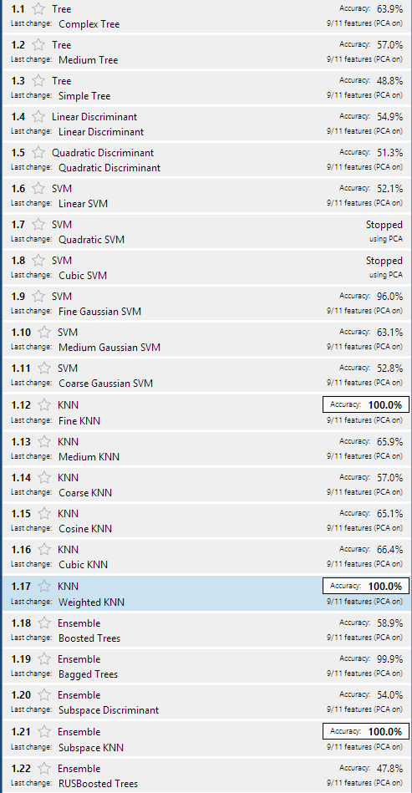
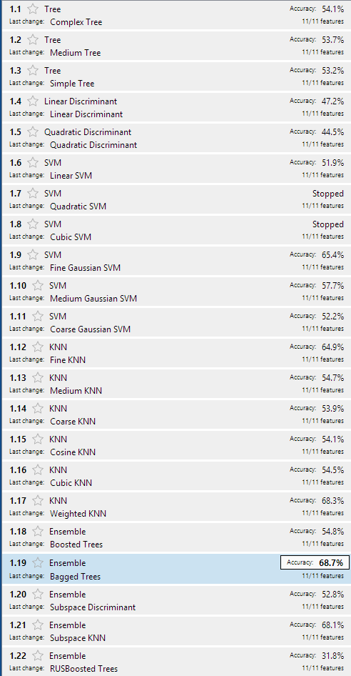
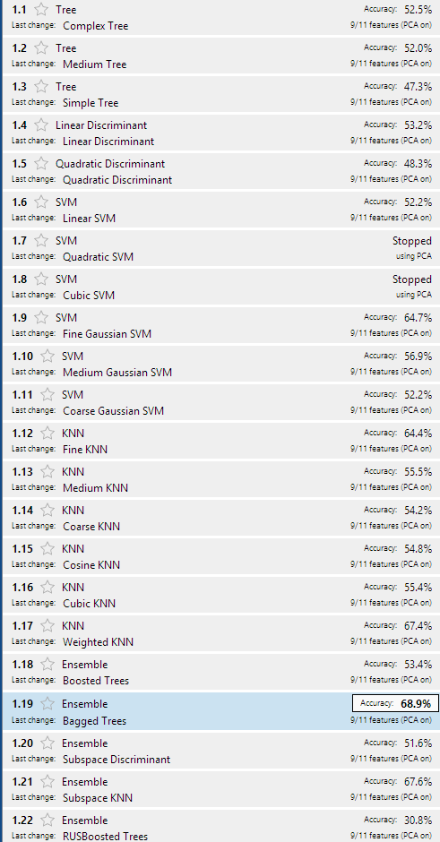
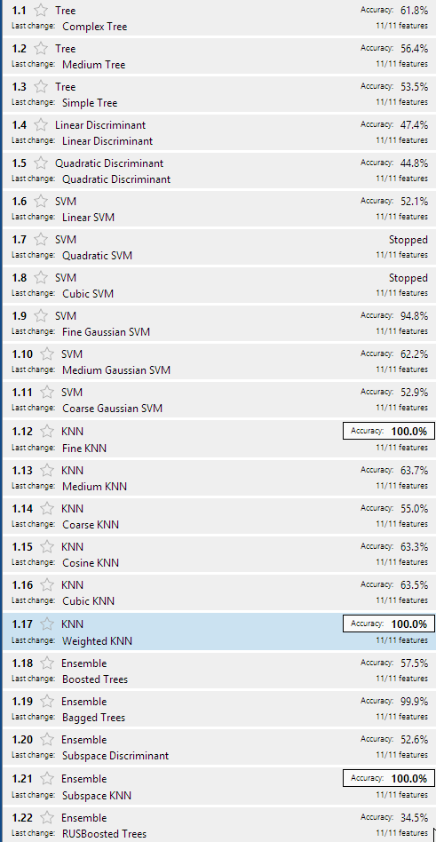
RED
WHITE
Bins = 2 PCA = 1 CV = 10 θ = 11
Bins = 2 PCA = 1 CV = 0 θ = 11
Bins = 2 PCA = 0 CV = 10 θ = 11
Bins = 2 PCA = 0 CV = 10 θ = 11
Bins = 2 PCA = 1 CV = 10 θ = 11
Bins = 2 PCA = 1 CV = 0 θ = 11
WHITE
WHITE
Bins = 4 PCA = 0 CV = 10 θ = 11
Bins = 7 PCA = 0 CV = 10 θ = 11
Bins = 7 PCA = 1 CV = 10 θ = 11
Bins = 7 PCA = 1 CV = 0 θ = 11
Bins = 4 PCA = 1 CV = 10 θ = 11
Bins = 4 PCA = 1 CV = 0 θ = 11

Slide 13
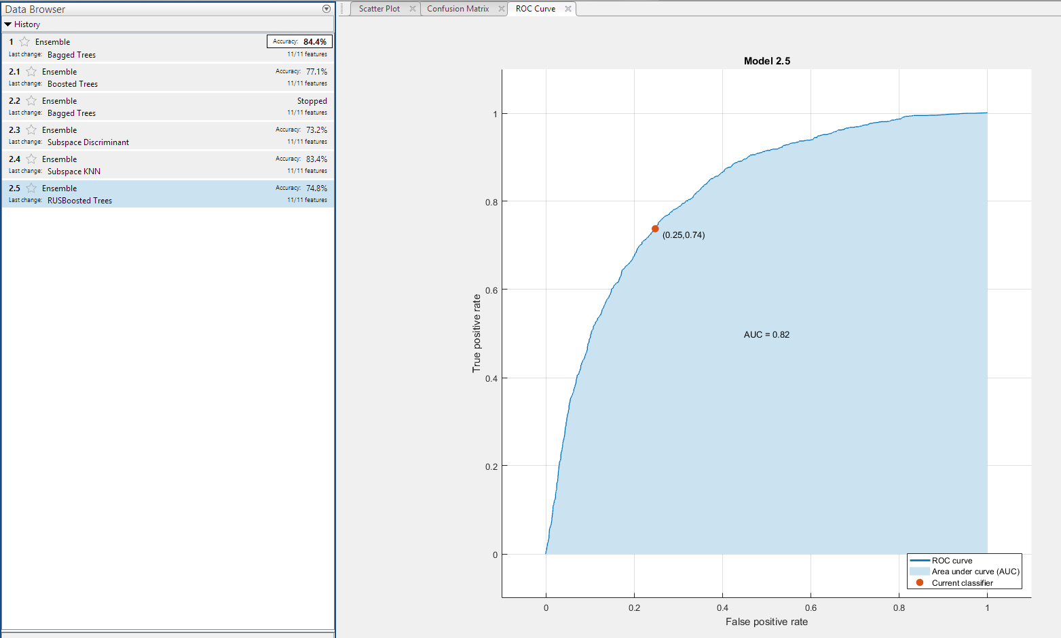
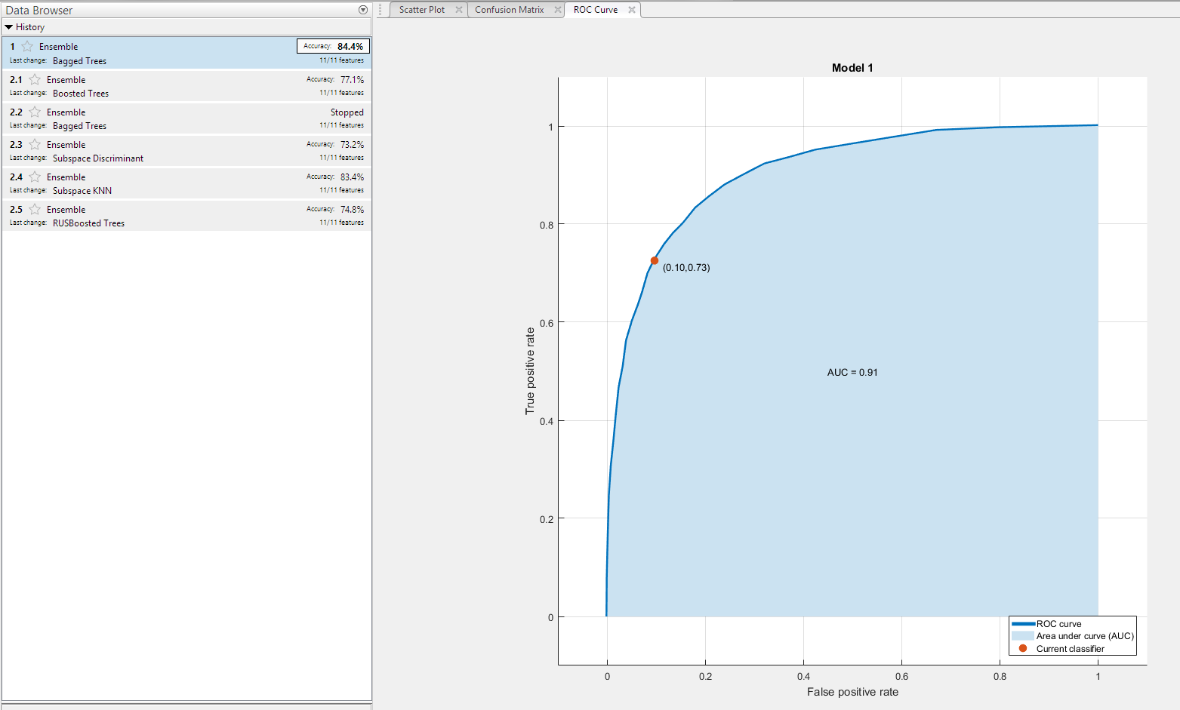
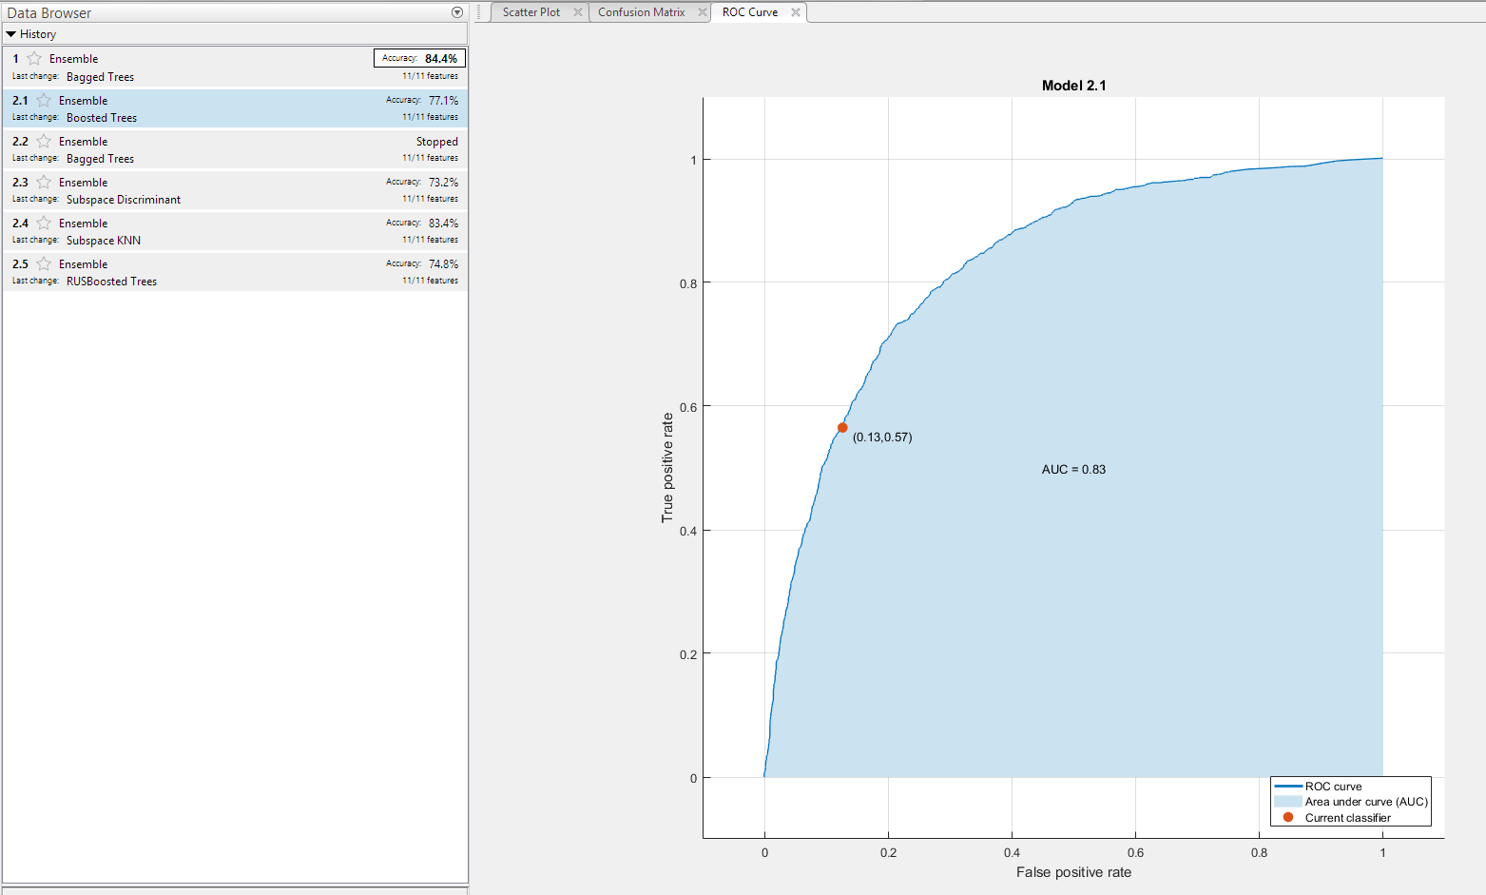
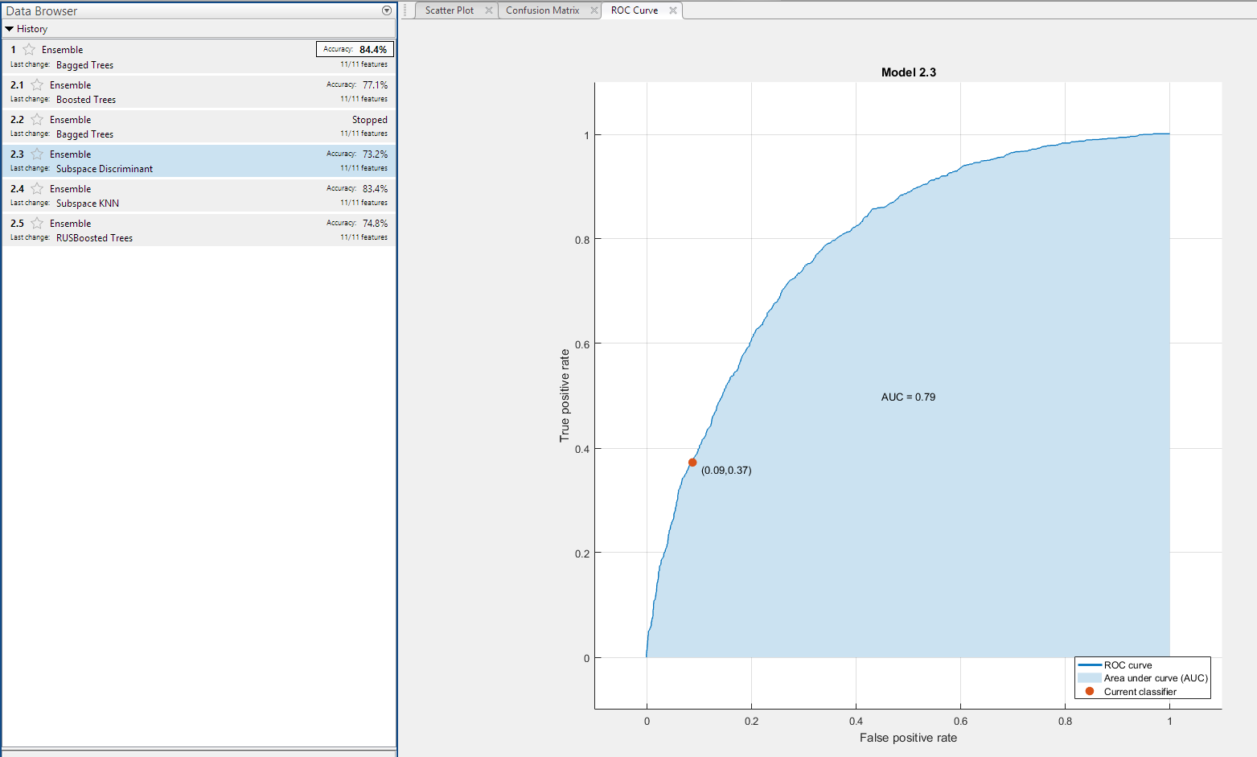
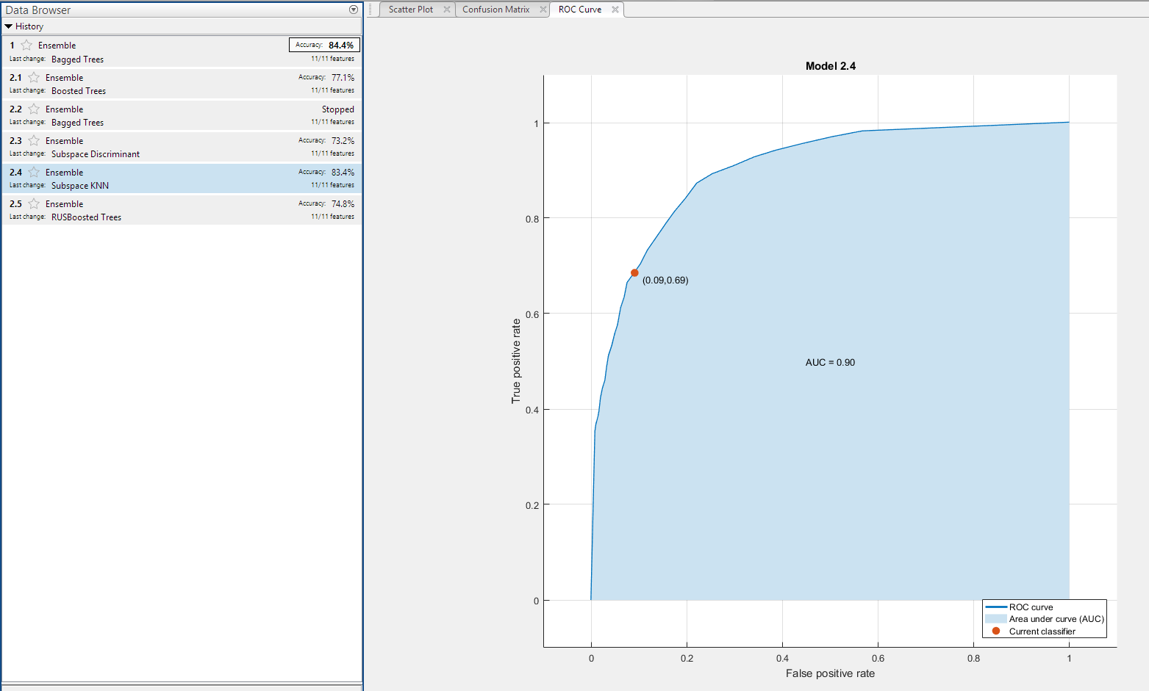
Bins = 2 PCA = 0 CV = 10 θ = 11

Slide 14
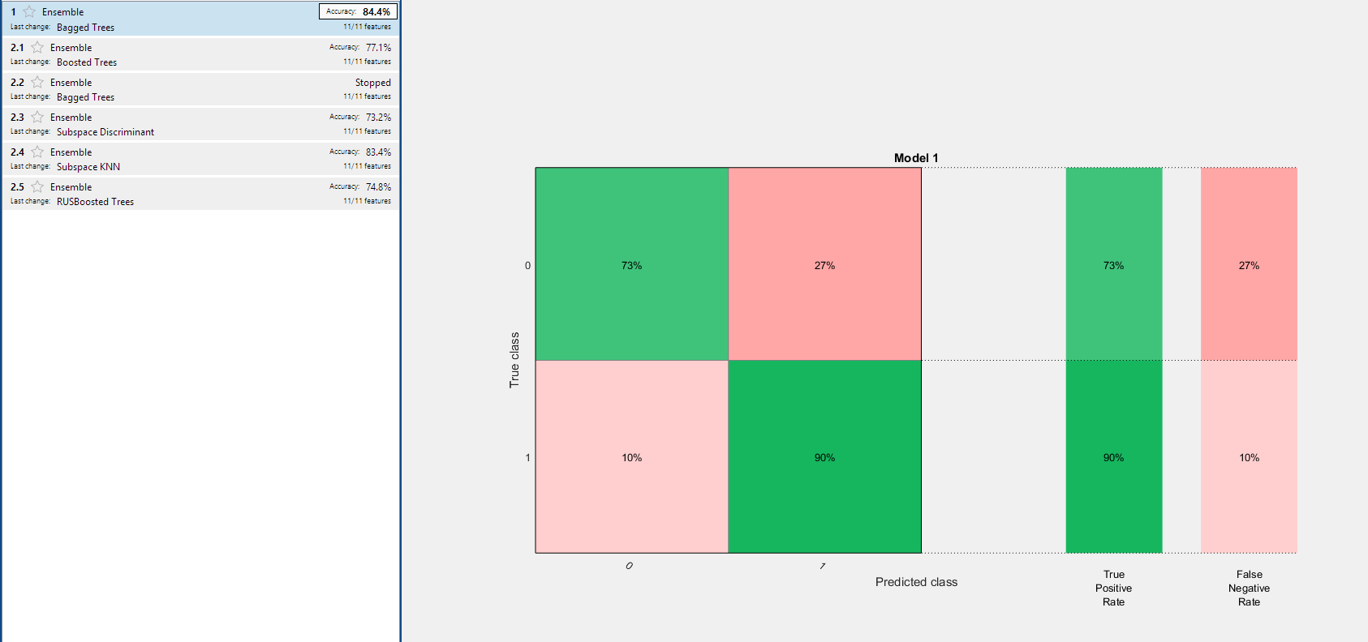
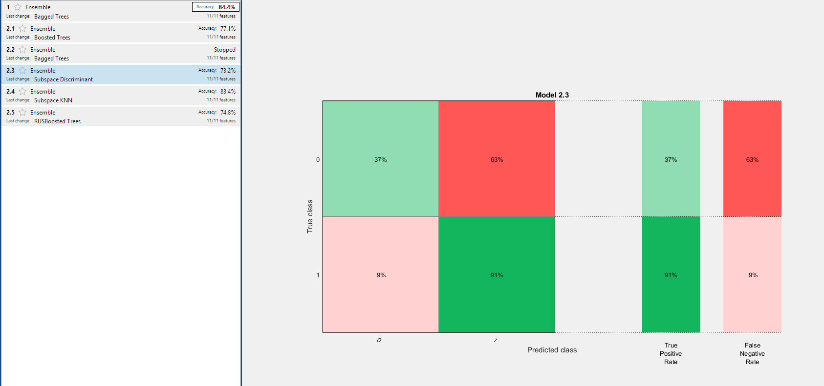
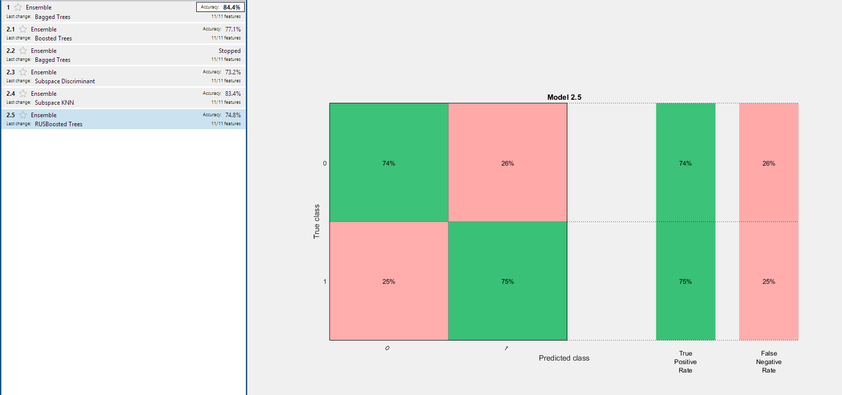
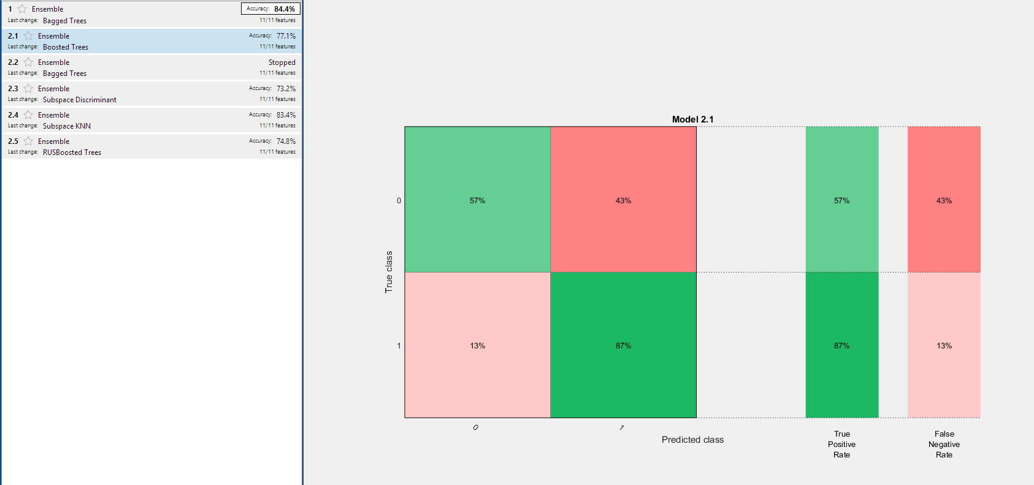
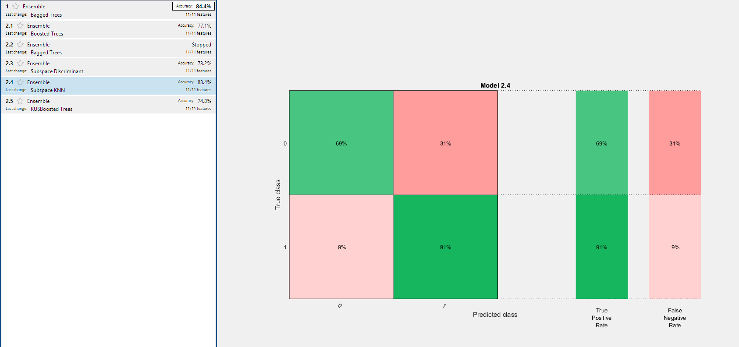
Bins = 2 PCA = 0 CV = 10 θ = 11
Notes:
This has been an arduous process

Slide 15
270 Pre-Regularized Models
2 bins
Ensemble > KNN > SVM
4 bins
Ensemble > KNN > SVM
7 bins
Ensemble > KNN > SVM
Bagged Tree Ensemble was most Accurate
Notes:
Vote on the best model, which is a model that votes among all others.

Slide 17
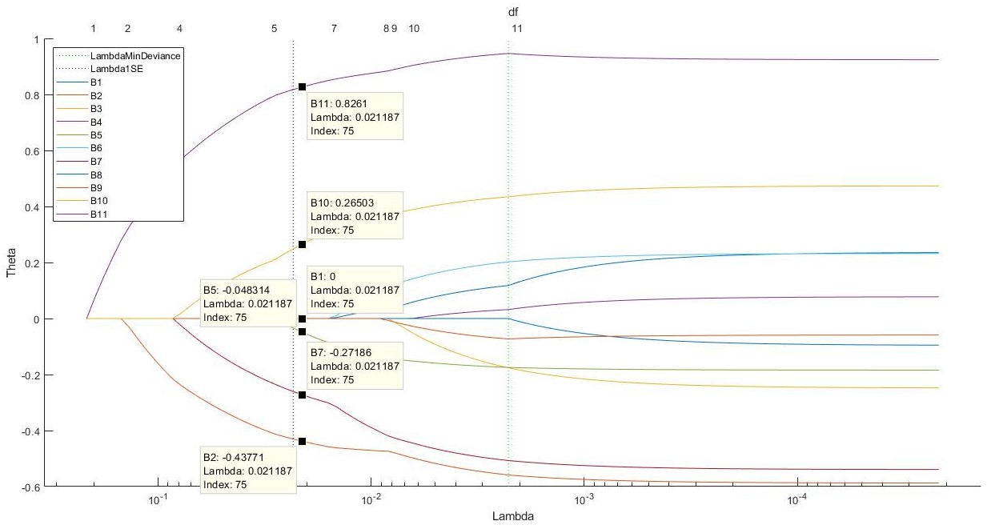
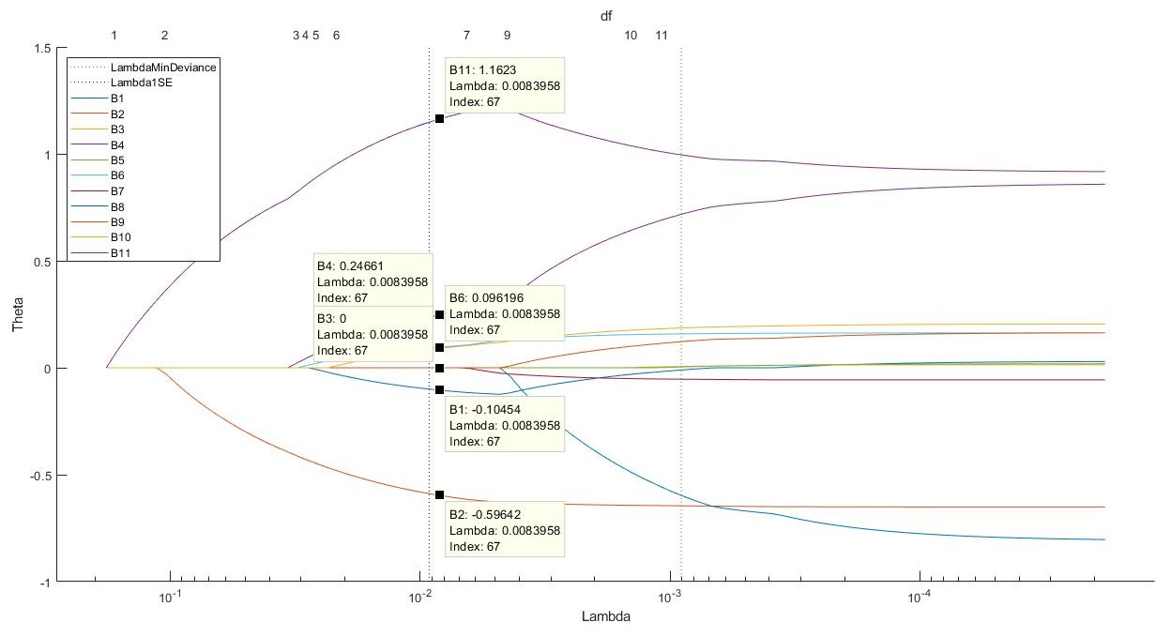
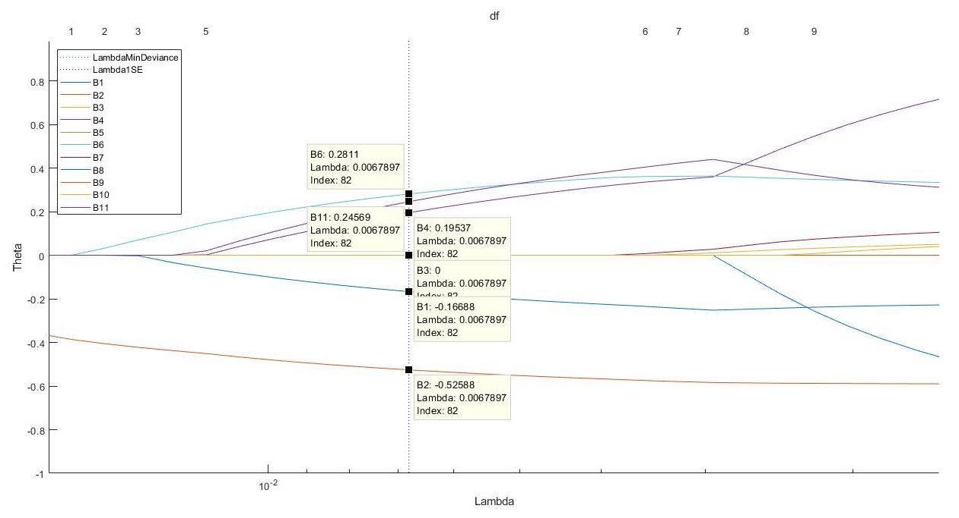
Lasso Regularization
2 bin: volatileacidity, chlorides, totalsulfurdioxide, sulphates, alcohol
4 bin: volatileacidity, freesulfurdioxide, density, alcohol
7 bin: freesulfurdioxide, volatileacidity, density, chlorides, alcohol
Notes:
Huimin

Slide 18
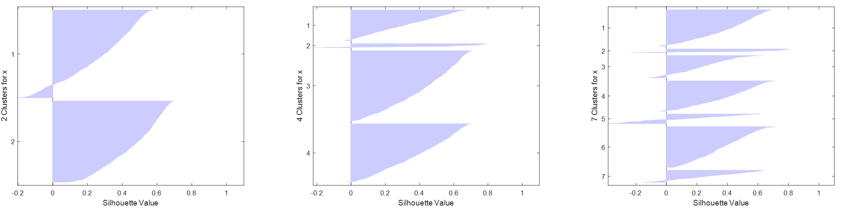
Again: Any Natural Cluster? K-Means
Before: cluster2 = 0.3533, cluster4 = 0.2012, cluster7 = 0.1741
After: cluster2 = 0.3562, cluster4 = 0.3895, cluster7 = 0.3344
Notes:
Huimin: Silhouette plot shows how well-separated the resulting clusters are. It displays a measure of how close each point in one cluster is to points in the neighboring clusters. This measure ranges from >=1, indicating points that are very distant from neighboring clusters, through 0, indicating points that are not distinctly in one cluster or another, to -1, indicating points that are probably assigned to the wrong cluster.

Slide 19
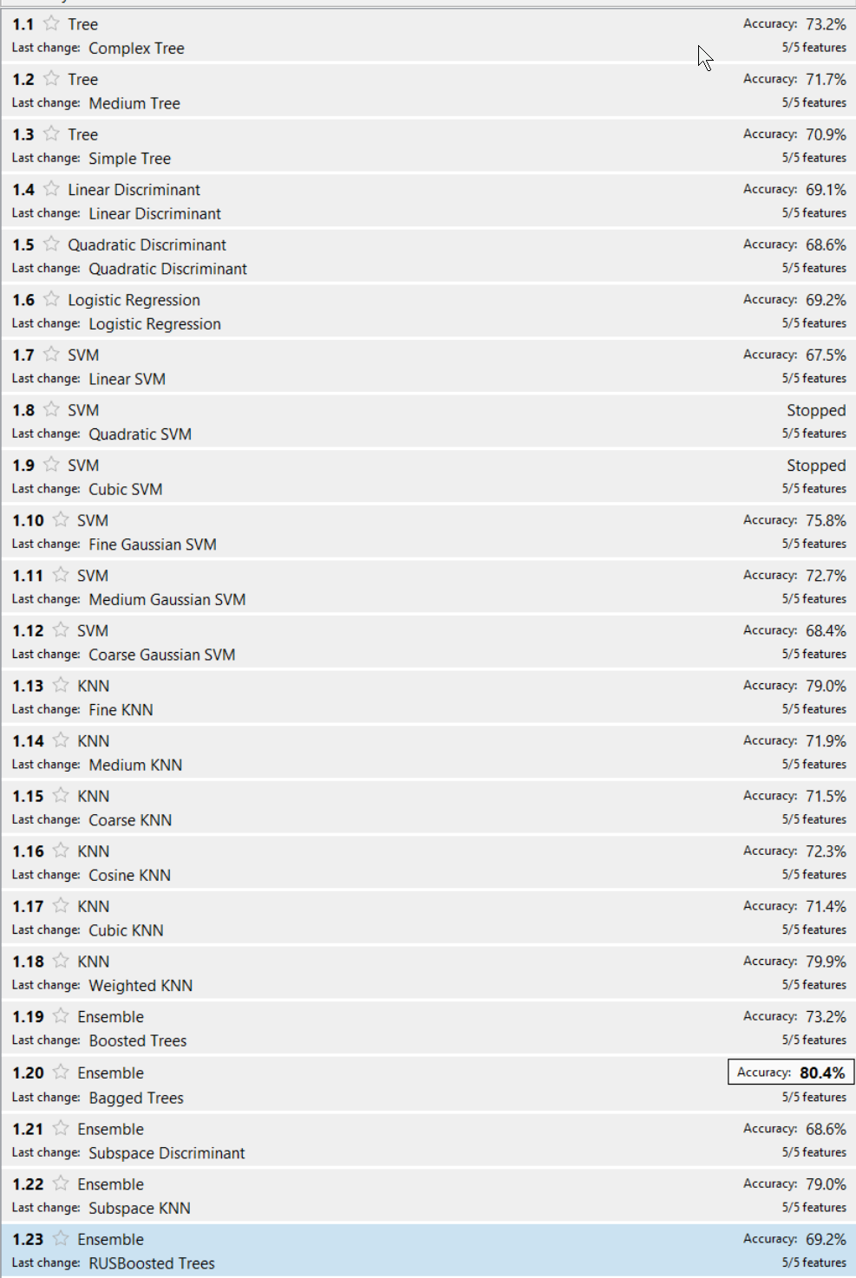
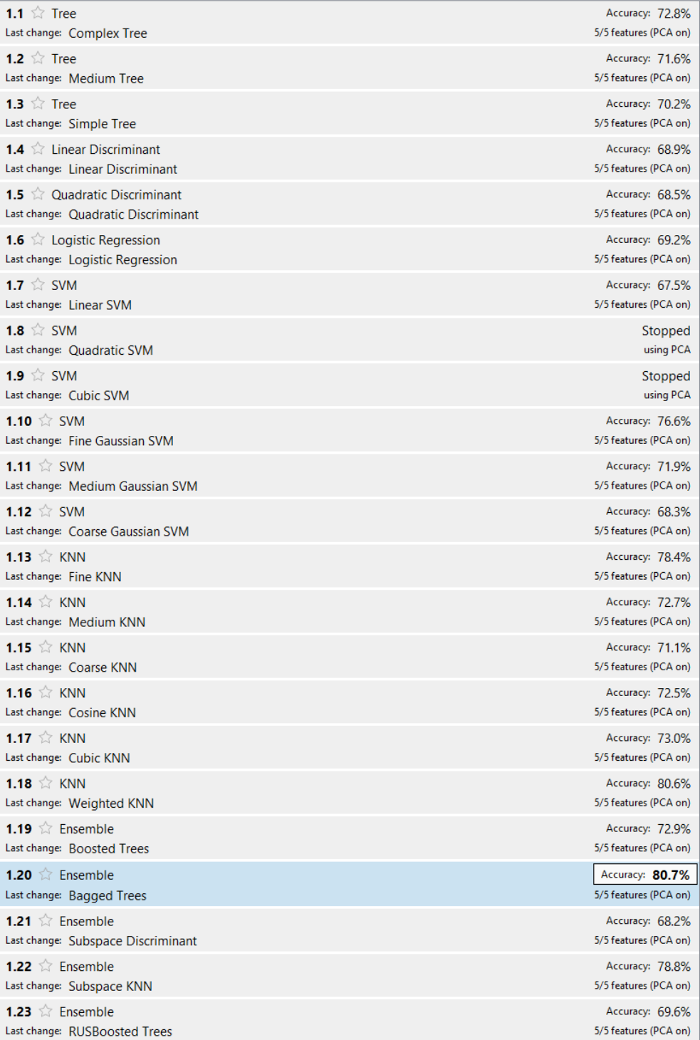
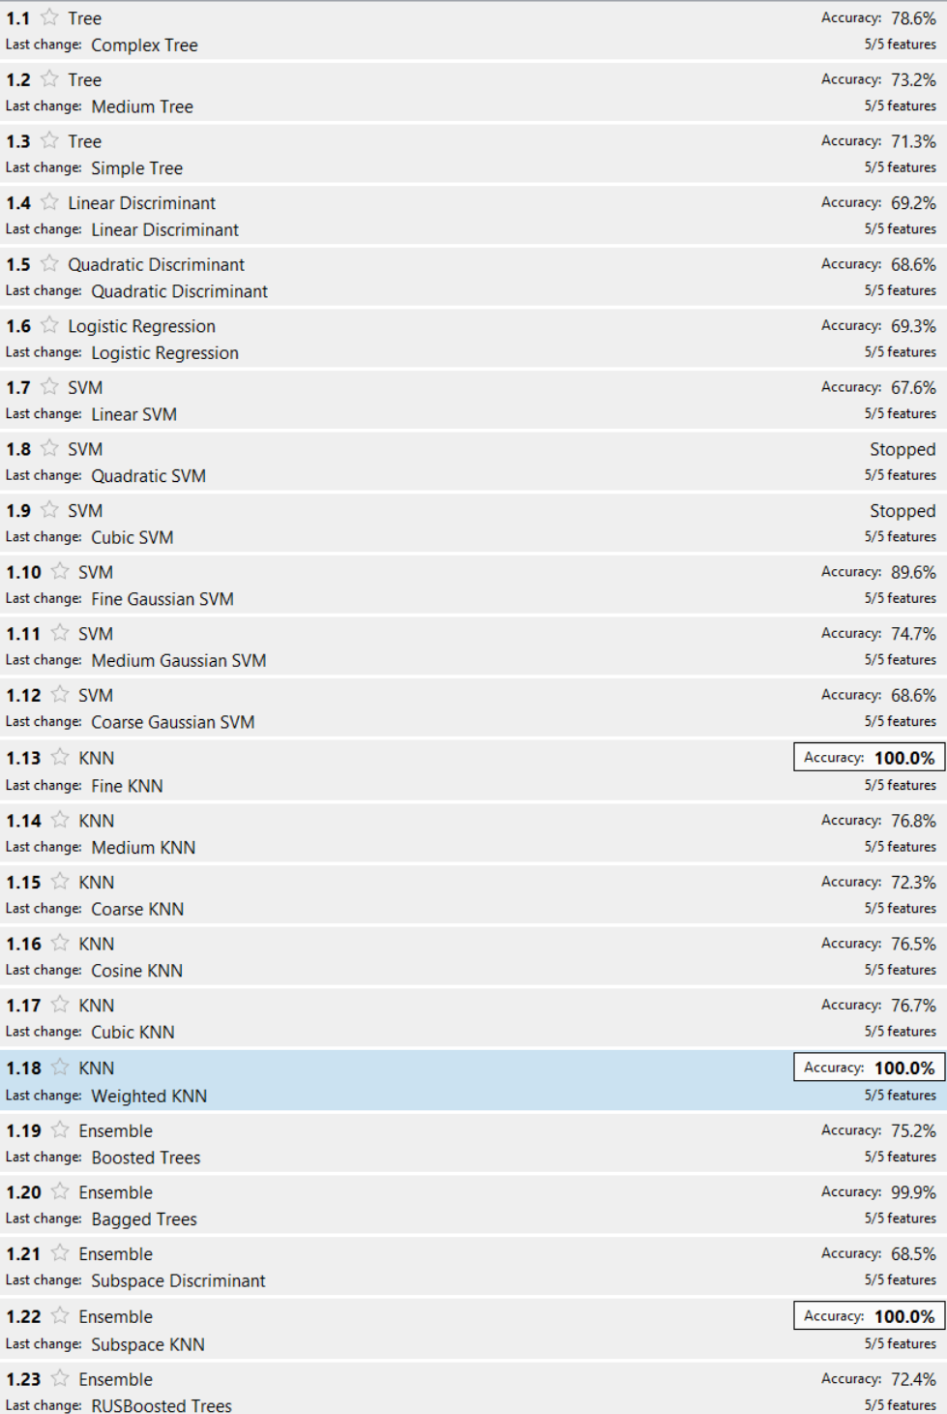
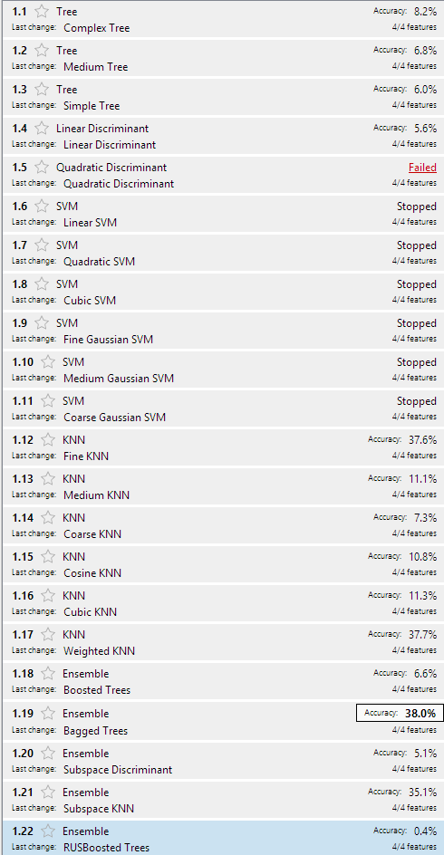
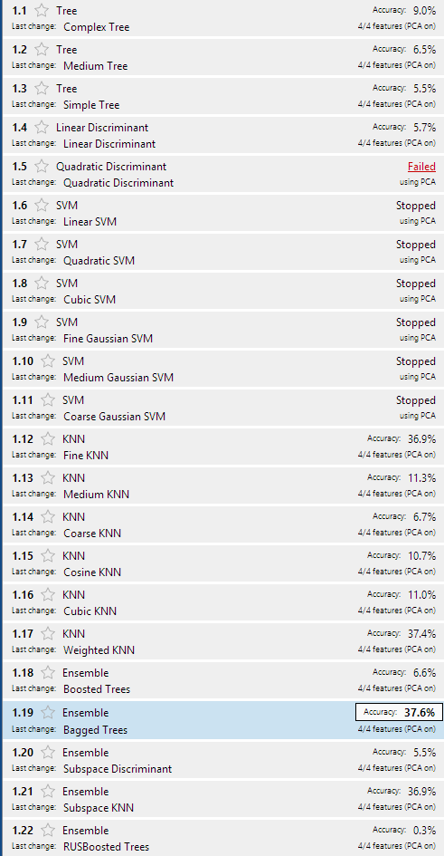
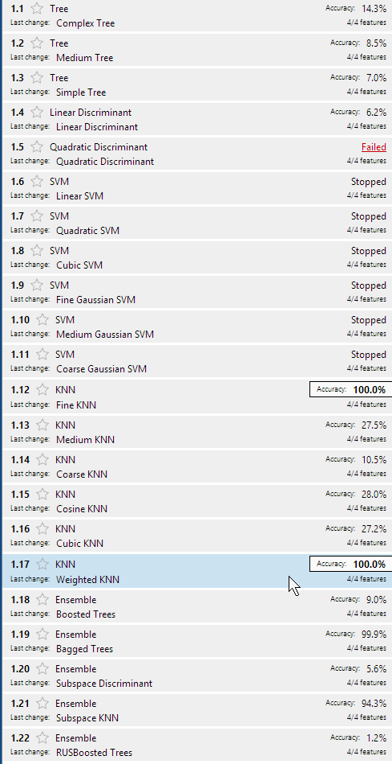
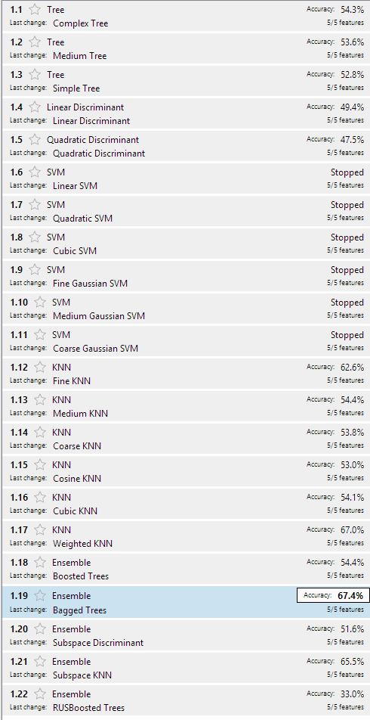
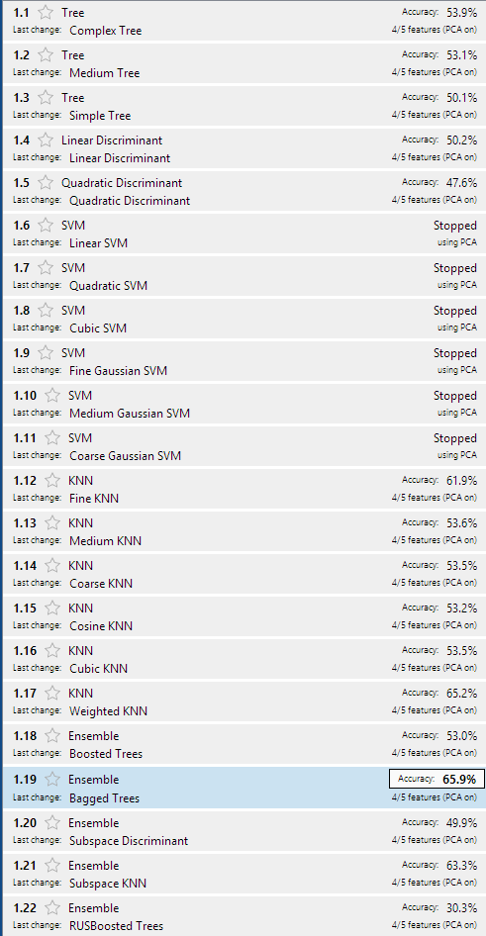
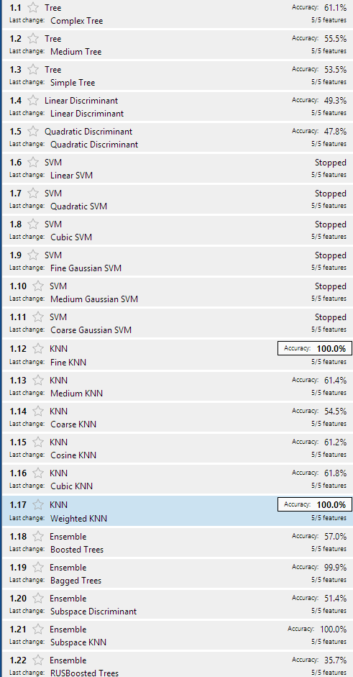
WHITE
WHITE
Bins = 4 PCA = 0 CV = 0 θ = 5
Bins = 4 PCA = 1 CV = 10 θ = 5
Bins = 2 PCA = 0 CV = 10 θ = 5
Bins = 4 PCA = 0 CV = 10 θ = 5
Bins = 2 PCA = 1 CV = 10 θ = 5
Bins = 2 PCA = 0 CV = 0 θ = 5
WHITE
Bins = 7 PCA = 0 CV = 10 θ = 5
Bins = 7 PCA = 1 CV = 10 θ = 5
Bins = 7 PCA = 0 CV = 0 θ = 5
Notes:
SVM quadratic and cubic processed for 30 minutes+, whereas for red dataset they processed for about 2 minutes.
CV = 0 produced poor results. Why?

Slide 20
WHITE
Bins = 2 PCA = 0 CV = 10 θ = 5
Bins = 2 PCA = 1 CV = 10 θ = 5
Bins = 2 PCA = 0 CV = 0 θ = 5
Notes:
SVM quadratic and cubic processed for 30 minutes+, whereas for red dataset they processed for about 2 minutes.
CV = 0 produced poor results. Why?

Slide 21
170 Post-Regularized Models
2 bins
Ensemble > KNN > SVM
4 bins
Ensemble > KNN > SVM
7 bins
Ensemble > KNN > SVM
Bagged Trees Ensemble was most Accurate
Ensemble is many Decision Trees
Decision Trees were most accurate as ensembles, but not individually
Going forward, focus is on 2 bins
Notes:
Vote on the best model, which is a model that votes among all others.

Slide 22
170 Post-Regularized Models
Regularizing the models slightly reduced accuracy
Notes:
Vote on the best model, which is a model that votes among all others.

Slide 24

Best Individual Model - Ensemble Bagged Tree
classificationEnsemble0 = fitensemble(...
predictors, ...
response, ...
'Bag', ...
30, ... % # trees
'Tree', ...
'Type', 'Classification', ...
'ClassNames', [1; 2]); Training time = 15.68 seconds
https://community.tibco.com/wiki/random-forest-template-tibco-spotfirer-wiki-page

Slide 25
Model Optimization
Train Optimized Ensemble Bagged Tree Model
Optimize using hyperparameters
Increase cross validation

Slide 26


Slide 27


Slide 28









Slide 29

Notes:
Too sparse

Slide 31
Hard and Soft Voting
Produce class and scores from most accurate models
Classes for hard voting
Probability Scores for soft voting
Ensemble Bagged
Weighted-KNN
SVM Fine Gaussian
Complex DT

Slide 32

Hard Voting
class_2_matrix = [... class_2_baggedensemble… class_2_ComplexDT... class_2_fineGaussianSVM … class_2_weightedKNN];
votesHard_class_2 = mode(class_2_matrix, 2);

Slide 33

Soft Voting
Follow whichever model is loudest
threemodels = [... score_2_ComplexDT… score_2_baggedensemble… score_2_weightedKNN];
[M, I] = max(threemodels, [], 2);

Slide 34
Soft Voting
% 0 predictors I(I == 1 | I == 3 | I == 5) = 8;
% 1 predictors I(I == 2 | I == 4 | I == 6) = 9;
I(I == 8) = 0; I(I == 9) = 1; votesSoft_class_2 = I;

Slide 35

Hard vs Soft Comparison
61 different
4.1% different
Soft voting predicts more class 1 (Good Wine)

Slide 36


Score
Hard Voting - Good Wine Prediction
Accuracy = 0.774
Precision = 0.658
Recall = 0.650
FScore = 0.654
Soft Voting - Good Wine Prediction
Accuracy = 0.784
Precision = 0.610
Recall = 0.690
FScore = 0.647

Slide 37


Model of Models
X
kfold = 10; alpha = 1; [B FitInfo] = lasso(X, Y, 'CV', kfold, 'Alpha', alpha);

Slide 38
Regrets
Wish List
Built Model of Models with Test data
Standardized data before train-test split
Train-Test Split rearranged categories
Only three class 9 observations in full dataset. Test didn’t have a 9. Classes later indexed to 0, causing misalignment (suspicion).
No Minimum Spending Tree for clustering
Produce a training-testing error graph
Compare models with more than just accuracy
Adjust more hyperparameters dials
Via parameter sweep
Regularize Bagged Tree Ensemble
Include more models in voting
Explore Red Wine dataset
Notes:
2 minutes

Slide 39





Sources/references
Professor Chih Lai
Data source: http://archive.ics.uci.edu/ml/datasets/Wine+Quality
Book 1 - https://www.amazon.com/Machine-Learning-Absolute-Beginners-Introduction-ebook/dp/B06VXKBLNG
Book 2 - https://www.amazon.com/Hands-Machine-Learning-Scikit-Learn-TensorFlow/dp/1491962291
Book 3 - https://www.amazon.com/gp/product/1600490069/ref=oh_aui_detailpage_o09_s01?ie=UTF8&psc=1
Diagram - https://docs.microsoft.com/en-us/azure/machine-learning/studio/studio-overview-diagram
One hot - https://docs.scipy.org/doc/numpy/reference/generated/numpy.digitize.html
Classification Learner - https://www.mathworks.com/help/stats/train-classification-models-in-classification-learner-app.html
Ensemble - https://stats.stackexchange.com/questions/349540/hard-voting-soft-voting-in-ensemble-based-methods
Everything Else - https://stackoverflow.com/
Notes:
1 minutes

Slide 40

Thank you!

